Slide 1
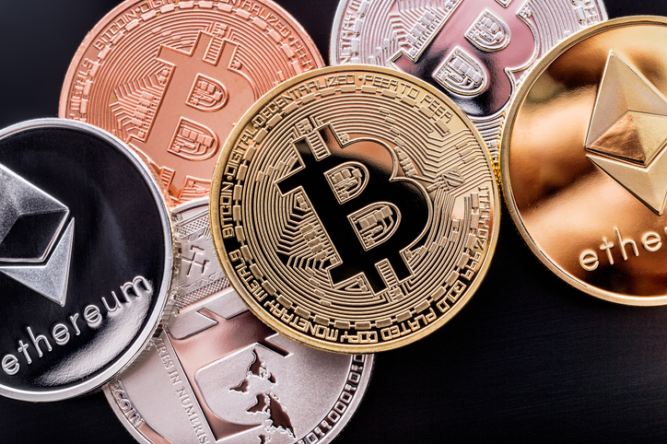
BLOCKCHAIN PROJECT: Group 6
AKASH SAHOO: B2019061
ANIRUDH NAIK GAUNKER: B2019064
MIMA NATEKAR: B2019080
PRITHA ROY CHOUDHURY: B2019089

Slide 2
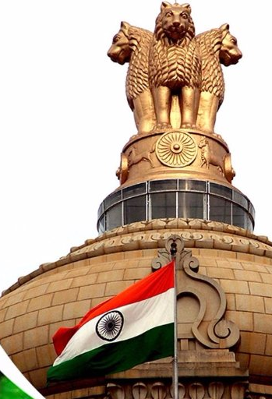
PROBLEM STATEMENT
Indian Government has approached a team of Blockchain Developers to create a secure crypto currency which will be monitored by the government for a approval system for verification of individual transactions,
Salient features which were demanded by the Govt Authorities are as follows:
Strong Cryptography security.
Traceability of transactions
Decentralized Peer-to-Peer secure transactions

Slide 3
SWOT ANALYSIS
Strengths
Robust
Tamper Proof
Weakness
Initial Phase
Volatile Market
Market Potential
Threats
Speed
Transparency
Privacy Protection
Network dependent
Opportunities
User friendly
Lack of Awareness
Tracing Black money
Competitors controlling the market

Slide 4
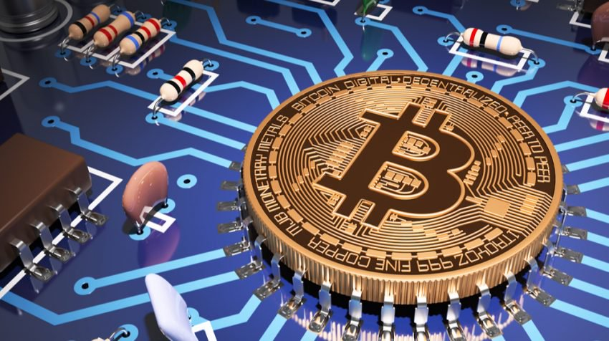
Bharat Coin Features
Miner 1
Miner 3
Miner 4
Miner 5
Miner 6
Miner 2
Miner 7
Proof Of Work
SHA512 Hash Algorithm
Transaction Details
Sender Name
Sender PAN Details
Receiver Name
Receiver PAN Details
Amount
Network of 7 Miners
Secured By PAN Verification
Created a Database for Secured Transactions

Slide 5
BLOCKCHAIN IMPLEMENTATION
Get Chain Function
Connect Node Function
Connection of 7 miners into interconnected network.
Genesis Block Creation
Mine Block Function
Default transaction for that particular node.
Replace Chain Function
Broadcast to other users.
Transaction valid Function
Add Transaction Function
Give Sender, Receiver and amount details to add into memory pool.
Validation of the transaction

Slide 6
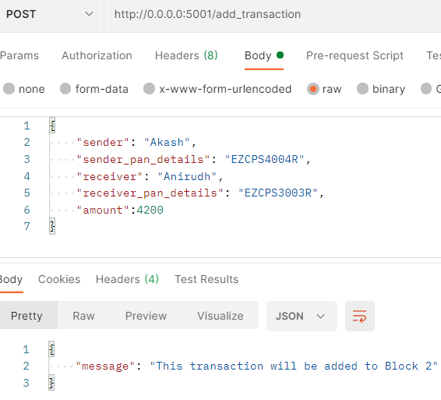
BLOCKCHAIN IMPLEMENTATION
NAME | PAN DETAILS
Akash | EZCPS2002R
Anirudh | EZCPS3003R
Pritha | EZCPS4004R
Mima | EZCPS5005R
Virat | EZCPS6006R
Sachin | EZCPS7007R
Suresh | EZCPS8008R
Ryan | EZCPS9009R
Elon | EZCPS1001R
ADD TRANSACTION (Valid)
Created a Database of 10 PAN Cards
If entered PAN details are valid, then only it will be added to the block.

Slide 7
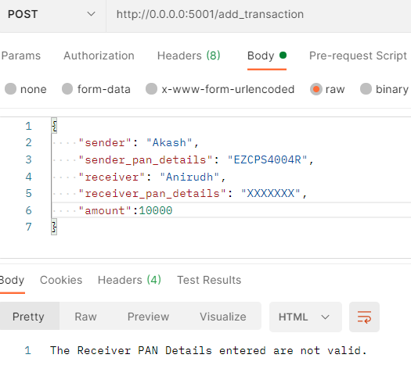
BLOCKCHAIN IMPLEMENTATION
NAME | PAN DETAILS
Akash | EZCPS2002R
Anirudh | EZCPS3003R
Pritha | EZCPS4004R
Mima | EZCPS5005R
Virat | EZCPS6006R
Sachin | EZCPS7007R
Suresh | EZCPS8008R
Ryan | EZCPS9009R
Elon | EZCPS1001R
ADD TRANSACTION (Invalid)
Created a Database of 10 PAN Cards
If entered PAN details are not valid, then it will show error.

Slide 8
Conclusion
Secured and Encrypted network.
Virtual Currency has high market potential globally. So, the Government should introduce crypto currencies.
Moving away from physical cash to complete electronic money based system should have a technology that is resilient.
It can be added as an alternate source of income for the Govt. by introducing taxes provided Bharat Coin is considered as a capital asset.

Slide 9
THANK YOU

